Slide 1
Build a private blockchain
Blockchain Conference
Pad Kankipati

Slide 2
Presenters
Pad Kankipati
VP of Architecture, Loyal Health
Pratik Patel
IBM - Lead Developer Advocate
Pad Kankipati

Slide 3
Prerequisites
Download Python 3.6+, Flash and requests library and pip..
Checklist:
Install Python 3.6+ https://www.python.org/downloads/
Install pip (if not installed already by Python)
Install Flask and Requests libraries.
pip install Flask==0.12.2 requests==2.18.4
What IDE to use?
Install PyCharm or any other IDE.. (Community edition)
https://www.jetbrains.com/pycharm/download/
HTTP client?
Finally a HTTP client like Postman or Curl? Postman: https://www.getpostman.com/
PLEASE REGISTER SLACK: tech404.github.io Channel: #blockchainconf
WIFI: SID: EVENTS
Username: blockchain
Password: blockchain2018

Slide 4
What is blockchain?
A blockchain is a decentralized, distributed and incorruptible digital ledger that is used to record transactions across many computers

Slide 5
Blockchain Simple terms
Distributed network of computers (nodes)
where each node contains a chain-of-blocks
where each block contains a ledger with a list of transactions
where each transaction is incorruptible (i.e. cryptographically secure)
& is linked to the previous transactions for the resource it is representing.
Blockchain is an immutable, sequential chain of records called Blocks.
Blocks contain transactions, files or any data you like
Blocks are chained together using hashes

Slide 6
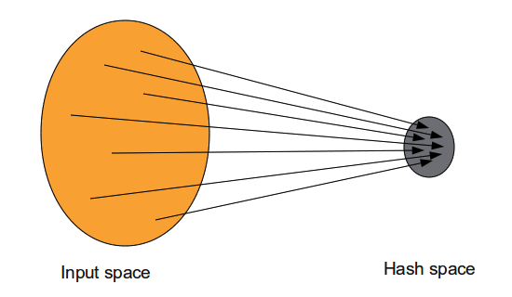
Incorruptible (“cyrpto” of cryptocurrency)
Achieves this by using 3 concepts:
1. Hash Functions (H(x)): A function which is used to convert a random set of input to an output of a fixed size.
For any input x, H(x) is the value of the hash function.

Slide 7
Incorruptible (contd).
2. Digital Signatures: Digital signatures are like our normal signatures in digital form. They need to have this basic property:
Only you can sign BUT anyone can verify.
Uses Private Key to sign and Public key to verify
Bitcoin uses (Elliptical Curve Digital Signature Algorithm) ECDSA for digital signatures.

Slide 8
Elliptical curve cryptography (ECC)
Public key encryption technique to create faster, smaller and efficient cryptographic keys.
Used for encrypting public keys
Relatively easy to verify, very difficult to traverse back to obtain critical private data
Bitcoin, Ethereum etc use, secp256k1 (y² = x³ + 7)

Slide 9
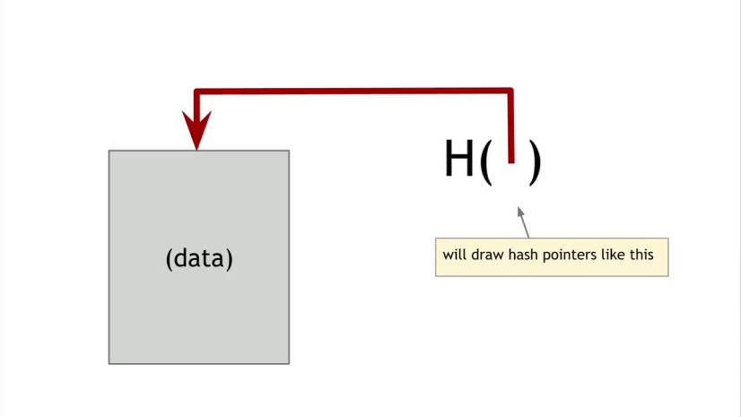
Incorruptible (contd).
3. Hash Pointers
Hash pointer is another good data structure that is leveraged in the blockchain

Slide 10
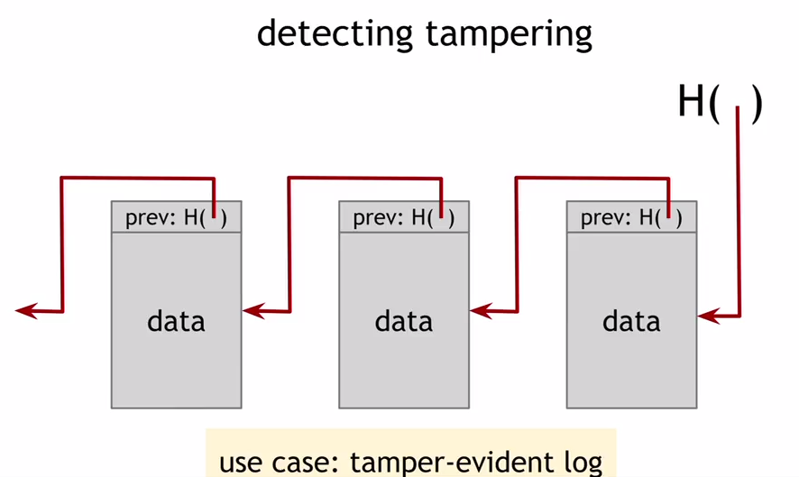
Incorruptible (contd).

Slide 11
Incorruptible (contd).
Block 1 (from the left) contains the data and a hash-pointer to the previous block. Block 2 contains a pointer and the hash of the first block and also its data.
Key point is that hash is the hash of data and the hash of previous block combined.
H(this-block) = H(H(previous-block) + data-in-this-block)

Slide 12
Incorruptible (contd).
Effectively, altering any unit of information on the blockchain would mean using a huge amount of computing power to override the entire network. And any block can validate whether this transaction is valid or not by following all the previous blocks in the chain.

Slide 13
Merkle Tree
Better data structure to avoid traversal of all blocks
The one used by Bitcoin and Ethereum is known as Merkle Tree.

Slide 14
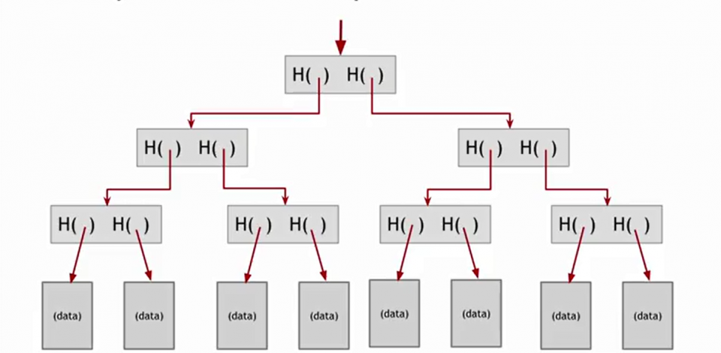
Merkle Tree
The idea here is to quickly validate a transaction by going from root to leaf rather than traversing all the blocks linearly

Slide 15
Decentralized & Distributed Ledger
A basic Peer to Peer network
Everybody is responsible for keeping the entire set of data and keeping checks on each other
Consensus among nodes is used to keep the distributed ledger in-tact, using incentives and Proof of work

Slide 16
Incentives & Proof of Work
Addition of each block (ie transaction(s)) and creation of coin is managed by computational activity called “Proof of Work”
Whenever a new block is added by an honest computer, it gets reward or coin, incentivizing the miner
It is similar to mining gold etc., except CPU time and electricity is expended
A computer only gets paid if the block ends up in the longest-chain
There is additional Transactional fee to whoever creates a block and puts the transaction

Slide 17
Nonce
The goal of PoW is to discover a number which solves a problem
The number must be difficult to find but easy to verify—computationally speaking—by anyone on the network. This is the core idea behind Proof of Work.
We vary the string by adding an integer value to the end called a nonce and incrementing it each time until the hash (SHA-256) starts with “0000”

Slide 18
Nonce
For eg: with “Hello world” we keep adding the number and hash it until it starts with “0000”, as we can see difficulty keeps going up until attempt 4251.
Attempt1 => "Hello, world!0" => 1312af178c253f84028d480a6adc1e25e81caa44c749ec81976192e2ec934c64
Attempt2 => "Hello, world!1" => e9afc424b79e4f6ab42d99c81156d3a17228d6e1eef4139be78e948a9332a7d8
Attempt3 => "Hello, world!2" => ae37343a357a8297591625e7134cbea22f5928be8ca2a32aa475cf05fd4266b7 ... ... ... ... ...
Attempt4249 => "Hello, world!4248" => 6e110d98b388e77e9c6f042ac6b497cec46660deef75a55ebc7cfdf65cc0b965
Attempt4250 => "Hello, world!4249" => c004190b822f1669cac8dc37e761cb73652e7832fb814565702245cf26ebb9e6
Attempt4251 => "Hello, world!4250" => 0000c3af42fc31103f1fdc0151fa747ff87349a4714df7cc52ea464e12dcd4e9

Slide 19
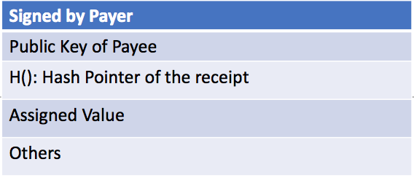
Transactions
In blockchain, every coin (or entity) is defined as chain of digital signatures
Each owner digitally signs the hash of previous transaction and the public key.
A simple transaction would look like

Slide 20
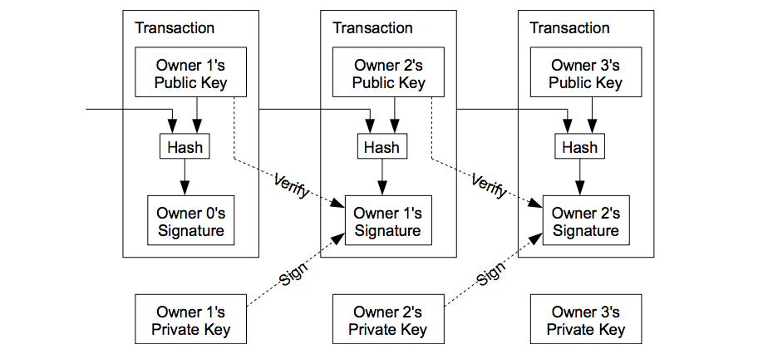
Transactions
This process continues to verify the chain of ownership (end-to-end)

Slide 21
Double spend and longest chain
Verify that the owner did not spend the same coin at two different entities, ie double-spend
Nodes always consider the longest-chain to be the correct one and will keep working on extending it

Slide 22
Conclusion
New transactions are broadcast to all nodes.
Each node collects new transactions into a block.
Each node works on finding a “difficult” proof-of-work for its block.
When a node finds a proof-of-work, it broadcasts the block to all nodes (and gets paid)
Nodes accept the block only if all transactions in it are valid and not already spent.
Nodes express their acceptance of the block by working on creating the next block in the chain, using the hash of the accepted block as the previous hash.

Slide 23
Let’s dig in

Slide 24
Prerequisites
Download Python 3.6+, Flash and requests library and pip..
Checklist:
Install Python 3.6+ https://www.python.org/downloads/
Install pip (if not installed already by Python)
Install Flask and Requests libraries.
pip install Flask==0.12.2 requests==2.18.4
What IDE to use?
Install PyCharm or any other IDE.. (Community edition)
https://www.jetbrains.com/pycharm/download/
HTTP client?
Finally a HTTP client like Postman or Curl? Postman: https://www.getpostman.com/

Slide 25
Steps to create and run a blockchain
Step 1: Building a Blockchain
Step 2: Blockchain as an API
Step 3: Interacting with our blockchain
Step 4: Consensus
Step 5: Test the chain
That’s it.

Slide 26
Step 1: Building a Blockchain
In Pycharm create a new file blockchain.py
It’ll store transactions and have some helper methods for adding new blocks to the chain.
class Blockchain(object):
def __init__(self):
self.chain = []
self.currentTransactions = []
def new_block(self):
# Creates a new Block and adds it to the chain
pass
def new_transaction(self):
# Adds a new transaction to the list of transactions
pass
@staticmethod
def hash(block):
# Hashes a Block
pass
@property
def last_block(self):
# Returns the last Block in the chain
pass

Slide 27
What does a block has?
A Block has
Index
Timestamp
A list of transactions
A Proof
And a Hash to the previous Block.
block = {
'index': 1,
'timestamp': 1506057125.900785,
'transactions': [
{
'sender': "8527147fe1f5426f9dd545de4b27ee00",
'recipient': "a77f5cdfa2934df3954a5c7c7da5df1f",
'amount': 5,
}
],
'proof': 324984774000,
'previous_hash': "2cf24dba5fb0a30e26e83b2ac5b9e29e1b161e5c1fa7425e73043362938b9824"
}

Slide 28
Adding Transactions to a Block
Add the code to new transaction method:
def new_transaction(self, sender, recipient, amount):
"""
Creates a new transaction to go into the next mined Block
:param sender: <str> Address of the Sender
:param recipient: <str> Address of the Recipient
:param amount: <int> Amount
:return: <int> The index of the Block that will hold this transaction
"""
self.currentTransactions.append({
'sender': sender,
'recipient': recipient,
'amount': amount,
})
return self.last_block['index'] + 1

Slide 29
Creating new Blocks
When new block is created we need to seed with “Genesis” block – a starting block.
We also need to add Proof to our genesis block, result of mining (proof of work)
We will update methods
new_block(), new_transaction() and hash():

Slide 30
import hashlib
import json
from time import time
class Blockchain(object):
def __init__(self):
self.chain = []
self.currentTransactions = []
self.nodes = set() # Set of nodes - only unique values are stored - idempotent.
# create genesis block.
self.new_block(previous_hash=1, proof=100)
def new_block(self, proof, previous_hash):
"""
Create a new block in the blockchain.
:param proof: <int> The proof given by the proof of the work algorithm
:param previous_hash: (Optional) <str> Hash of the previous block.
:return: new block
"""
block = {
'index': len(self.chain) + 1,
'timestamp': time(),
'transactions': self.currentTransactions,
'proof': proof,
'previous_hash': previous_hash or self.hash(self.chain[-1]),
}
# Reset the current list of transactions
self.currentTransactions = []
self.chain.append(block)
return block

Slide 31
def new_transaction(self, sender, recipient, amount):
"""
Creates a new transaction to go into the next mined block.
:param sender: <str> Address of the sender
:param recipient: <str> Address of the recipient
:param amount: <int> amount
:return: <int> index of the block that holds the transaction
"""
self.currentTransactions.append({
'sender': sender,
'recipient' : recipient,
'amount' : amount,
})
return self.last_block['index'] + 1
@property
def last_block(self):
# Returns the last block in the chain.
return self.chain[-1]
@staticmethod
def hash(block):
"""
Creates a SHA-256 hash of a block.
:param block: <dict> block
:return: <str> hash of the block.
"""
# Make sure the dictionary is Ordered, otherwise we will have inconsistent hashes
block_string = json.dumps(block, sort_keys=True).encode()
return hashlib.sha256(block_string).hexdigest()

Slide 32
Proof of Work
A Proof of Work is how new Blocks are created or mined on the blockchain.
The goal of PoW is to discover a number which solves a problem.
The number must be difficult to find but easy to verify – by anyone in the network.
For eg: hashing the previous and current hash and incrementing the number until the hash starts with 4 ‘0’s like ‘0000c3af42fc31103f1fdc0151fa747ff87349a4714df7cc52ea464e12dcd4e9’

Slide 33
Implementing Proof of Work
Implement the algorithm for our blockchain.
Find the number ‘p’ that when hashed with the previous block’s solution a hash with 4 leading 0’s is produced

Slide 34
import hashlib
import json
from time import time
from uuid import uuid4
class Blockchain(object):
...
def proof_of_work(self, last_block):
"""
Simple proof of work algorithm
- find a number 'p' such that hash(pp') contains last 4 leading zeroes, where p is the previous p'
- p is the previous proof, and p' is the new proof
:param last_block: last block
:return: <int>
"""
last_proof = last_block['proof']
last_hash = self.hash(last_block)
proof = 0
while self.valid_proof(last_proof, proof, last_hash) is False:
proof += 1
return proof
@staticmethod
def valid_proof(last_proof, proof, last_hash):
"""
Validates the Proof: Does hash(last_proof, proof) contains 4 leading zeroes?
:param last_proof: <int> Previous proof
:param proof: <int> current proof
:param last_hash: <str> The hash of the previous block
:return:<bool> True if correct, false if not
"""
guess = f'{last_proof}{proof}{last_hash}'.encode()
guess_hash = hashlib.sha256(guess).hexdigest()
return guess_hash[:4] == "0000"

Slide 35
Step 2: Blockchain as an API
We will use Python Flask, create 3 methods
/transactions/new: to create a new transaction to a block
/mine: to tell our server to mine a new block
/chain: to return the full blockchain
Runs as a server on port 5000

Slide 36
import hashlib
import json
from textwrap import dedent
from time import time
from uuid import uuid4
from flask import Flask
class Blockchain(object):
...
# Instantiate our Node
app = Flask(__name__)
# Generate a globally unique address for this node
node_identifier = str(uuid4()).replace('-', '')
# Instantiate the Blockchain
blockchain = Blockchain()
@app.route('/mine', methods=['GET'])
def mine():
return "We'll mine a new Block"
@app.route('/transactions/new', methods=['POST'])
def new_transaction():
return "We'll add a new transaction"
@app.route('/chain', methods=['GET'])
def full_chain():
response = {
'chain': blockchain.chain,
'length': len(blockchain.chain),
}
return jsonify(response), 200
if __name__ == '__main__':
app.run(host='0.0.0.0', port=5000)

Slide 37
Transactions endpoint
This is what a user will send to the server
{ "sender": "my address", "recipient": "someone else's address", "amount": 5 }
Update the new_transactions() method to implement the logic to add transactions to the block.

Slide 38
import hashlib
import json
from textwrap import dedent
from time import time
from uuid import uuid4
from flask import Flask, jsonify, request
...
@app.route('/transactions/new', methods = ['POST'])
def new_transactions():
values = request.get_json()
# Check that the required fields are in the POSTed data
required = ['sender', 'recipient', 'amount']
if not all (k in values for k in required):
return 'Missing values: {k}', 400
# Create a new transaction
index = blockchain.new_transaction(values['sender'], values['recipient'], values['amount'])
response = {'message': f'Transaction will be added to Block {index}'}
return jsonify(response), 200

Slide 39
Mining endpoint
Calculate Proof of work
Reward the miner by adding a transaction granting 1 coin
Forge the new block by adding to the chain.
We will update the mine() method to add the logic.

Slide 40
import hashlib
import json
from time import time
from uuid import uuid4
from flask import Flask, jsonify, request
...
@app.route('/mine', methods=['GET'])
def mine():
# We will run the proof of work algorithm to get the next proof..
last_block = blockchain.last_block
proof = blockchain.proof_of_work(last_block)
# We must receive a reward for finding the proof.
# The sender is "0" to signify that this node has mined a new coin.
blockchain.new_transaction(
sender = "0",
recipient=node_identifier,
amount=1,
)
# Forge the new block by adding it to the chain.
previous_hash = blockchain.hash(last_block)
block = blockchain.new_block(proof, previous_hash)
response = {
'message': 'New block forged',
'index': block['index'],
'transactions': block['transactions'],
'proof': block['proof'],
'previous_hash': block['previous_hash'],
}
return jsonify(response), 200

Slide 41
Step 3: Interacting with our blockchain
Fire up the server
python blockchain.py
* Running on http://127.0.0.1:5000/ (Press CTRL+C to quit)
Use Postman to mine a block (GET) :
http://localhost:5000/mine

Slide 42
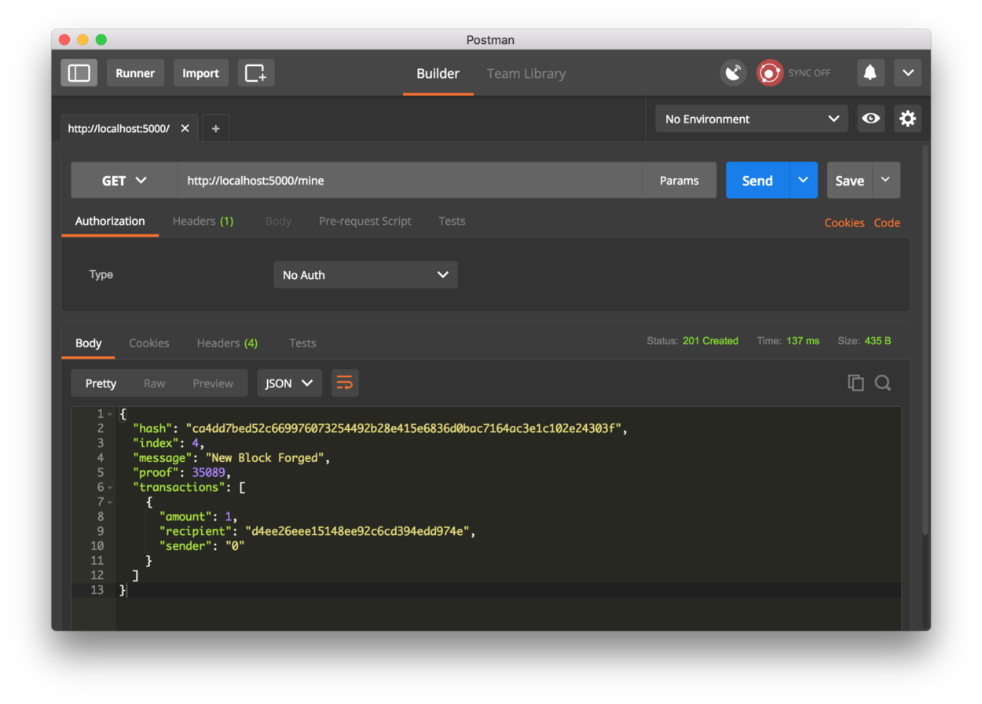

Slide 43
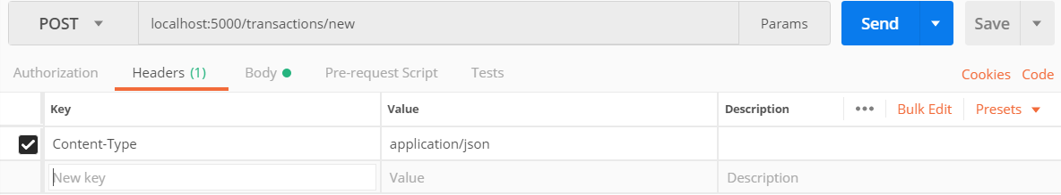
Create a new transaction
Postman create a POST request
http://localhost:5000/transactions/new
Headers:
Body (JSON) RAW:
{
"sender": "3243c66fa5ce46658d57c3624f306e32",
"recipient": "some-other-user",
"amount": 8
}

Slide 44
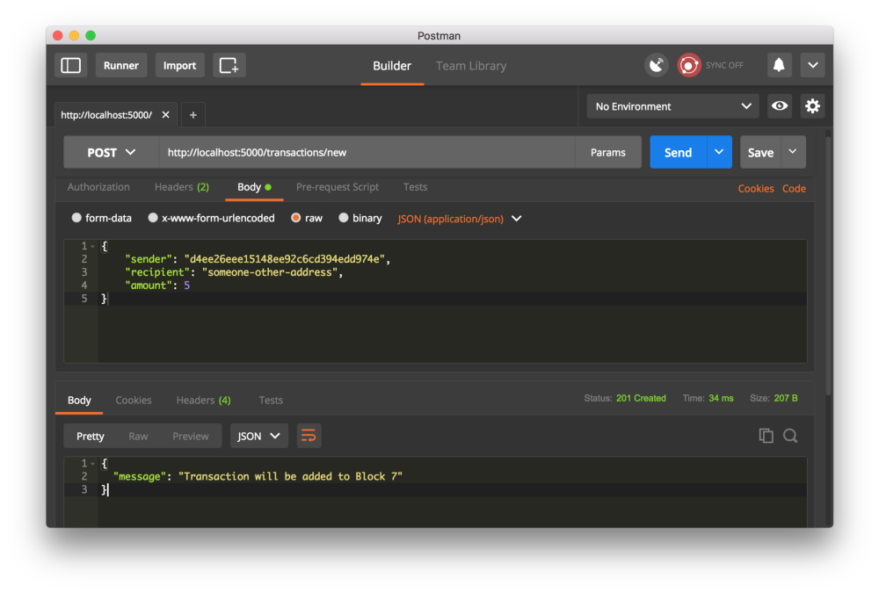

Slide 45
More mining
Mine multiple times by using (GET)
http://localhost:5000/mine
And inspect the chain by calling in a Browser or Postman
http://localhost:5000/chain

Slide 46
{ "chain": [ { "index": 1, "previous_hash": 1, "proof": 100, "timestamp": 1506280650.770839, "transactions": [] }, { "index": 2, "previous_hash": "c099bc...bfb7", "proof": 35293, "timestamp": 1506280664.717925, "transactions": [ { "amount": 1, "recipient": "8bbcb347e0634905b0cac7955bae152b", "sender": "0" } ] }, { "index": 3, "previous_hash": "eff91a...10f2", "proof": 35089, "timestamp": 1506280666.1086972, "transactions": [ { "amount": 1, "recipient": "8bbcb347e0634905b0cac7955bae152b", "sender": "0" } ] } ], "length": 3 }

Slide 47
Yay!! We got basic blockchain. More…

Slide 48
Step 4: Consensus
Consensus allows the blockchains to be decentralized.
For consensus to work, all nodes should be aware of its’ neighbors by registering and resolving differences
/nodes/register: to accept a new list of new nodes
/nodes/resolve: implement consensus algorithm, resolves any conflicts
Add these methods to the blockchain code

Slide 49
...
from urllib.parse import urlparse
...
class Blockchain(object):
def __init__(self):
...
self.nodes = set() # Set of nodes - only unique values are stored - idempotent.
...
def register_node(self, address):
"""
Add a new node to the list of nodes.
:param address: <str> address of the node eg: http://192.168.0.10:5005
:return: None
"""
parsed_url = urlparse(address)
if parsed_url.netloc:
self.nodes.add(parsed_url.netloc)
elif parsed_url.path:
# Accepts an URL with path '192.168.0.0:5000'.
self.nodes.add(parsed_url.path)
else:
raise ValueError('Invalid URL')

Slide 50
Implement Consensus algorithm
A conflict is when one node has a different chain than another node
To resolve, our rule is the ‘longest valid chain is authoritative’
Ie, the longest chain on the network is the de-facto one.
Let’s implement the valid_chain method and resolve_conflicts method on blockchain.py
valid_chain() – loops through blocks and verifies both hash and proof.
resolve_conflicts() – loops through neighbors, downloads their chains, and verifies. If a valid chain is found, whose length is greater than ours, we replace ours.

Slide 51
...
import requests
class Blockchain(object)
...
def valid_chain(self, chain):
"""
Determine if a given blockchain is valid. Consensus - longest valid chain is authoritative.
:param chain: <list> a blockchain
:return: <bool> True if valid, False if not.
"""
last_block = chain[0]
current_index = 1
while current_index < len(chain):
block = chain[current_index]
print(f'lastBlock: {last_block}')
print(f'currentBlock: {block}')
print("\n\n--------------------\n")
# Check that the hash of the block is correct
last_block_hash = self.hash(last_block)
if block['previous_hash'] != last_block_hash:
return False
# Check if the proof of work is valid.
if not self.valid_proof(last_block['proof'], block['proof'], last_block_hash):
return False
last_block = block
current_index += 1
return True

Slide 52
def resolve_conflicts(self):
"""
This is our consensus algorithm, it resolves conflicts by replacing our chain with the longest chain
in the network
:return: <bool> True if the chain is replaced, False if not.
"""
neighbors = self.nodes
new_chain = None
# We're looking for chains longer than ours
max_length = len(self.chain)
# Grab and verify the chains from all nodes on the network
for node in neighbors:
print(f'requesting for node: {node}')
response = requests.get(f'http://{node}/chain')
print(f'node {node} - chain: {response}')
if response.status_code == 200:
length = response.json()['length']
chain = response.json()['chain']
# Check if the length is longer and is valid.
if length > max_length and self.valid_chain(chain):
max_length = length
new_chain = chain
# Replace our chain if the length is longer and valid.
if new_chain:
self.chain = new_chain
return True
return False

Slide 53
Add endpoints for consensus
Add 2 more methods to register and resolve
/nodes/register (POST)
/nodes/resolve (GET)

Slide 54
@app.route('/nodes/register', methods=['POST'])
def register_nodes():
values = request.get_json()
nodes = values.get('nodes')
if nodes is None:
return "Error, please supply a valid list of nodes", 400
for node in nodes:
blockchain.register_node(node)
response = {
'message': 'New nodes have been added',
'total_nodes': list(blockchain.nodes),
}
return jsonify(response), 201
@app.route('/nodes/resolve', methods = ['GET'])
def consensus():
replaced = blockchain.resolve_conflicts()
if replaced:
response = {
'message': 'Our chain got replaced',
'new_chain': blockchain.chain
}
else:
response = {
'message': 'Our chain is authoritative',
'chain': blockchain.chain
}
return jsonify(response), 200

Slide 55
Step 5: Test the chain
Fire up multiple nodes on different ports (use flaskrun to configure multiple ports)
python blockchain.py –p 5000
python blockchain.py –p 5001
…
Use Postman to register nodes
http://localhost:5000/register
Body:
{
“nodes”:[“http://127.0.0.1:5001”]
}

Slide 56
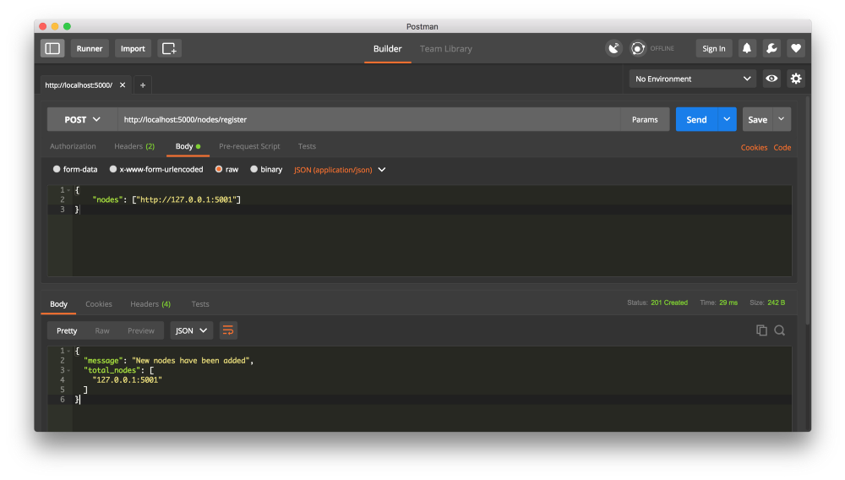

Slide 57
More testing..
Mine more blocks on nodes
Mine 3 blocks on node 2 to ensure chain was longer
And resolve to see consensus in work on node 1. See how chain gets replaced with longest chain
GET /nodes/resolve
Note: You can do a GET /chain on nodes to see the chain before calling resolve

Slide 58
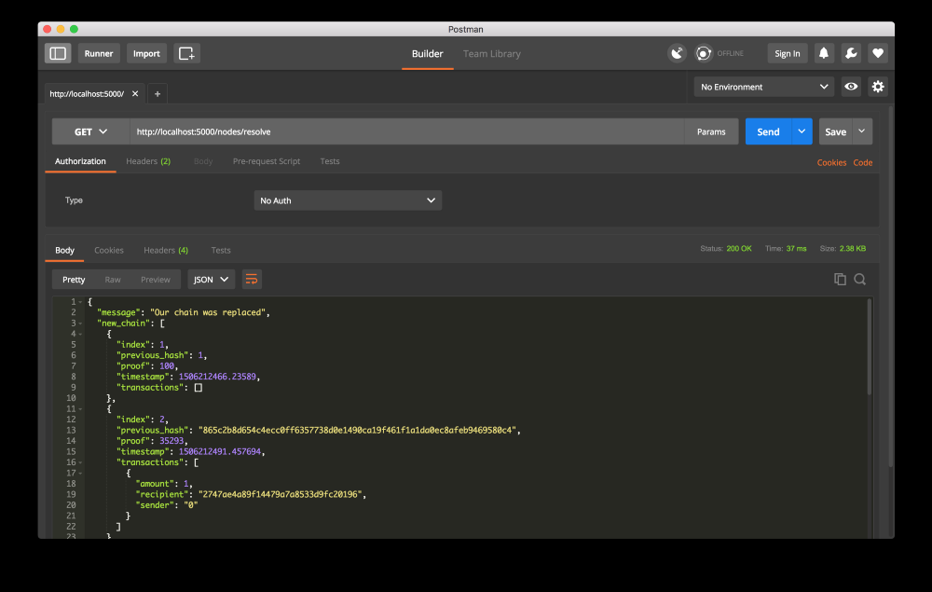

Slide 59
Yay!! We are done (for now)… Time for Q&A

Slide 60
Contact: Pad Kankipati
pkankipati@gmail.com
Meetup – Blockchain Hands-on Coding

